Slide 1

Getting Started With MongoDB

Slide 2

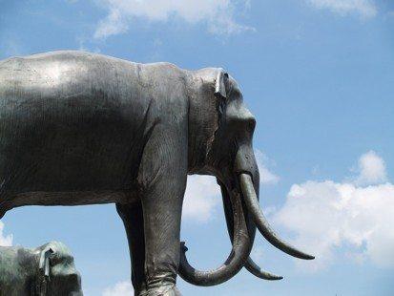

Agenda
MongoDB Overview
Mongo Test Drive Mongo Data Model CRUD Operations Working With Files

Slide 3


MongoDB Overview
Data Store for JSON Objects

Slide 4
MongoDB Overview
Data Store for JSON Objects
{
“Name” : “Rose Tyler”
}

Slide 5
JSON Objects
A JSON Object is a collection of key/value pairs
Keys are simple strings
Values can be: Numbers, Strings, Arrays, Other Objects, and more

Slide 6
JSON Examples
{
“name”: “The Doctor”, “age”: 900
}
{
“race”: “human”,
“body parts” : [“head”, “legs”, “arms”, “eyes”]
}

Slide 7
MongoDB Overview
A Document Oriented Database (No SQL)

Slide 8
Keeping It Simple

Slide 9
Keeping It Simple
No Transactions
No Joins

Slide 10



Application Architecture
SERVER
DB

Slide 11


What Can Mongo Do For You
Create and store objects
Arrange them in collections Retrieve them later

Slide 12


Q & A

Slide 13

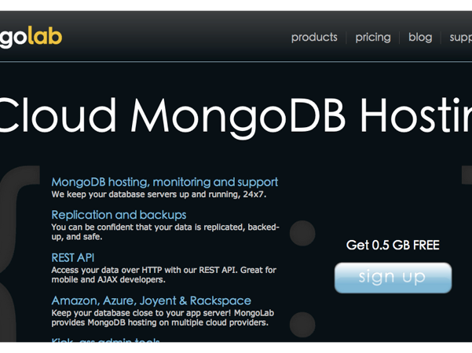
Mongo Test Drive
Create MongoLab Account And Start Using The DB

Slide 14
Install mongo Client
Download mongo from: http://www.mongodb.org/downloads
Extract zip file Run mongo

Slide 15


MongoLab

Slide 16
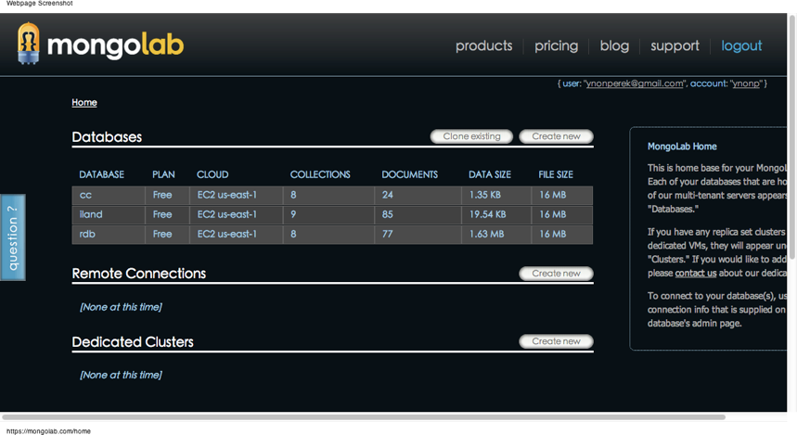
Database Dashboard

Slide 17
Create New Database
Choose database name
Choose provider
Choose plan (free is good) Create a DB user

Slide 18
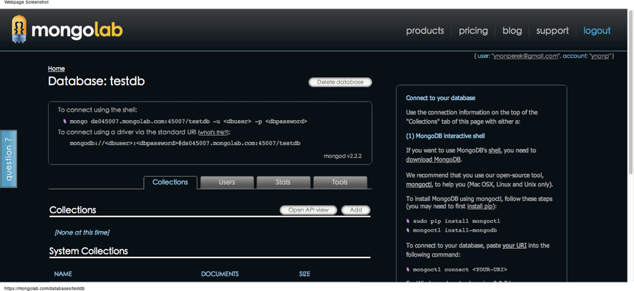

Database Dashboard

Slide 19
Connecting To The DB
There are two options to work with your new DB
You can use the web console
You can use the command line console Let’s start with the web.

Slide 20


Demo: Creating Documents
Create a few documents on the web console
Update the data Delete some of them Search by fields

Slide 21
Mongo Data Model
Let’s model A blog post in a blog app
What’s The Data ?
How Should You Save It ?

Slide 22
Cool MongoDB Design
{
“title”: “Mongo 101”,
“author” : “ynonp”,
“comments” : [
{ “author” : “...”, | “content” : | “...” | },
{ “author” : “...”, | “content” : | “...” | }
],
“tags” : [ “funny”, “informative”],
“content” : “...”
}

Slide 23
Q & A

Slide 24
Lab
Create a DB for musical info
Create a collection called albums
Add info for 3 albums you like, including:
Album Name, Artist, Tracks, Release Date, Genres Tracks is an array of objects
Genres is an array of strings

Slide 25

CRUD Operations
Create, Read, Update and Destroy Data

Slide 26
Mongo CRUD
Create
is called insert
Read is called find
Update is called update Destroy is called remove

Slide 27
Mongo CRUD
From a developer’s perspective, MongoDB operations are the same through the driver and through the console
In both cases, operations look like function calls or method invocations
We’ll use mongo shell for the rest of this chapter

Slide 28
Inserting Data
Use the command insert or save to insert a new object
db.collection.insert( obj ); db.collection.insert( array );

Slide 29
Inserting Data
Inserting to a new collection creates the collection
Inserting an object with an _id key, it is used as the object’s id (and must be unique).

Slide 30

Reading Data
find and findOne perform read operations
Both take a query
find returns a cursor
findOne returns an object
Optional: Fields to fetch
db.collection.find( <query>, <projection> )

Slide 31
Query Document
An empty (or missing) query document returns everything
db.collection.find({}) db.collection.find()

Slide 32
Query Document
Each key/value pair in the query document imposes a condition on the results (objects that match).
db.movies.find({ “genre” : “indie” });
db.books.find({“pages” : { “$gt” : 100 }});

Slide 33


Query Document
Query Object
Each key/value pair in the query document imposes a condition on the results (objects that match).
db.movies.find({ “genre” : “indie” });
db.books.find({“pages” : { “$gt” : 100 }});

Slide 34
Query Document
A compound query means a logical AND on the conditions.
db.inventory.find(
{
“type” : “snacks”,
“available” : { “$lt” : 10 }
});

Slide 35

Quiz: What Is Returned
from | alterego | publisher
Earth | Bruce Wayne | DC
Earth | Peter Parker | Marvel
Krypton | Clark Kent | DC
{
“publisher” : “DC”
}

Slide 36
Quiz: What Is Returned
from | alterego | publisher
Earth | Bruce Wayne | DC
Earth | Peter Parker | Marvel
Krypton | Clark Kent | DC
{
“publisher” : “DC”,
“from” : “Earth”
}

Slide 37
More Queries
You can use “$or” to have an OR expression
{
“$or” : [
{ “type” : “food” },
{ “type” : “drinks” }
]
}

Slide 38
Sub Documents
If your document has sub-documents, it’s possible to query by a full sub document or look for a partial match
Full sub-document query means subdocument is exactly as specified in the query
Example:
{ | ISBN : | { | “ISBN-10” : | “1906465592”,
 |  |  | “ISBN-13” : | “978-1906465599” | }}

Slide 39
Sub Documents
A partial query matches all objects that have at least the required field (but may contain more)
Example:
{
“language.primary” : “english”
}
Value of language is an object, and it has a field called
primary

Slide 40
Arrays
You can use an exact array match by providing the full array in the query
Example:
{
tags : [ “funny”, “cute”, “cats” ]
}

Slide 41
Arrays
You can query for an array that has at least one element matching the query
Example:
{ “tags” : “funny” }

Slide 42
Arrays
If you have a subdocument as the element of an array, it’s possible to query by its fields using the dot notation.
Examples:
{ “tracks.4.name” : “Rose Mary Stretch” }
{ “tracks.name” : “Rose Mary Stretch” }

Slide 43
Query Operators
Complex queries are performed with special operators.
These are reserved words starting with a $
Some of them: $gt, $gte, $lt, $lte, $ne, $in, $nin, $all,
$or, $not

Slide 44
Comparator Queries
Value for key a is greater than 10
{ “a” : { “$gt” : 10 }}
Value for key b is not 7
{ “b” : { “$ne” : 7 }}
Value for key name is greater (dictionary sort) than ‘bird’
{ “name” : { “$gt” : “bird” }}

Slide 45
Queries: $in, $nin
Use $in to specify a choice from multiple options
Value for grade is 85, 90 or 100
{ “grade” : { “$in” : [ 85, 90, 100 ] } }
Value for fruit is neither apple nor banana
{ “fruit” : { “$nin” : [“apple”, “banana” ] } }

Slide 46

Quiz: What Is Selected
{ “reads” : { “$gt” : 10 },
“author” : { “$nin” : [“admin”, “manager”, “boss” ] } }
author | reads | title
admin | 99 | How To Use Mongo
Joe | 120 | How To Make Money
Jim | 8 | Windows Manual

Slide 47
Queries: $all
Select objects with array containing all elements
Example:
{ “tags” : { “$all” : [ “funny”, “cats” ] } }

Slide 48
More Query Operators
“$size” - array has a specific number of elements
“$exists” - field present or missing Example:
{ “friends” : { “$size” : 7 } }
{ “producer” : { “$exists” : false } }

Slide 49
Aggregation
count() - returns how many objects found
distinct() - returns all distinct values for a key Example:
db.posts.distinct( “tags” )

Slide 50
Resources
Queries Cheat Sheet
https://github.com/vunb/backend-nodejs/blob/master/slides/Module%205/mongodb_qrc_queries.pdf

Slide 51
Q & A

Slide 52
Lab
Using the previously defined musical DB. Query for:
Albums released after/before 2008 Albums with 7 tracks
Albums by a specific genre Albums by a specific track name
Display ALL different genres in the DB

Slide 53
Update
Update operations modify existing data in the DB
Mongo supports two update commands:
update() and save()
Update is the more general (and complex)

Slide 54


Update
The general form for update is:
db.collection.update(
<query>, <update>, <options> )
Which Entries to update
What to do with them

Slide 55
Update
The second argument to update() is an operator object
It tells update what to do with the data
Some keys you can use: “$set”, “$inc” “$push”, “$pushAll”, “$addToSet”, “$pop”, “$pull”, “$pullAll”

Slide 56
Update: set
$set modifies a value or add a new value
Example:
db.posts.update(
);
{ | title: | “Why Is Your Cat Unhappy” | },
{ | $set : | { “archived” : true } }

Slide 57
Quiz: $set
What happens here ?
db.cats.update(
);
{ | color: “white” },
{ | “$set” : { “owners” : | [“John”, | “Jim”] | } | }

Slide 58
Quiz: $set
Update owners array of the first cat with white color
If you want to update all objects, use multi
db.cats.update(
{ color: “white” },
{ “$set” : { “owners” : [“John”, “Jim”] } }
{ multi : true }
);

Slide 59
Update: inc
$inc increases a numeric value
Example:
{ “$inc” : { “age” : 11 } }

Slide 60
Quiz: $inc
What happens here ?
db.songs.update(
{ | “title” : | “Killing Lies” | },
{ | “$inc” : | { “plays” : 1 } | }
);

Slide 61
Update: push and pushAll
push() and pushAll() add items to an existing array
If they array did not exists, it is created Example:
db.creatures.update(
{ name: “The Doctor” },
{ “$push” : { companions : “Rose Tyler” } }
)

Slide 62
Update: addToSet
The $addToSet adds a new item only if it wasn’t already in the array
Example:
{ “$addToSet” : { “tags” : “funny” } }

Slide 63
Update: pop
pop removes items of an array
Use a value of 1 to remove the last element Use a value of -1 to remove the first element Example:
{ “$pop” : { “companions” : 1 } }

Slide 64
Update: pull
Remove a specific item from an array.
Can use $pullAll to remove all matching elements Example:
{ “$pull” : { “companions” : “Rose Tyler” } }

Slide 65
Updating with save()
The second update operation is save()
takes a document:
If the document has an id - update it If not, insert it to the DB

Slide 66
Deleting Data
remove() deletes objects from a collection
Takes a query and possibly a <justOne> arguments Examples:
db.posts.remove({ “author” : “Father Angelo” }) db.music.remove({ “genres” : “pop” })
db.posts.remove({ “tags” : “funny” }, 1 );

Slide 67
Q & A

Slide 68
Lab
From the previous music database:
Add a new album with 4 tracks Add a new track to that new album
Set property “plays” on all albums to 6 Increase it by 4 only for “indie” albums Delete all “indie” music

